Slide 1
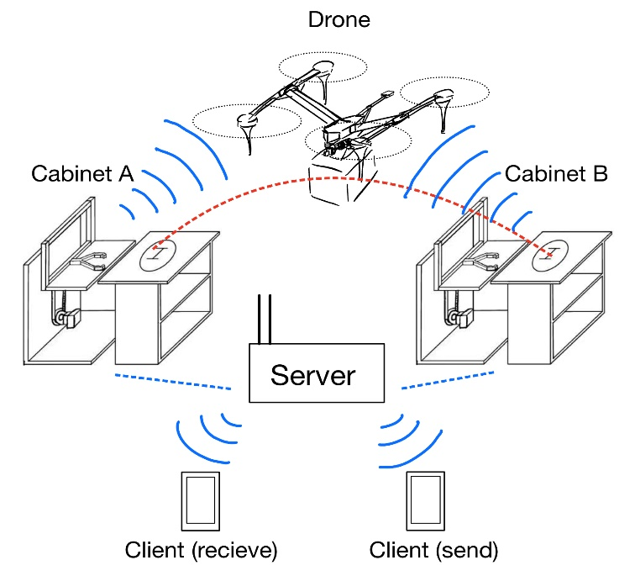
Drone Delivery System within Cities
Sponsor: | Jiahuan Cui
Affiliation: | ZJUI
Elec. | Comp. | Mech. | Civil
1 | 1 | 2 | 0
Description:
A lightweight airway delivery system based on ground RTK communication guidance. Realizing the functions of automatic receiving and placing goods, path planning according to order, high-precision positioned landing, intelligent management of goods, real-time feedback of logistics information, etc.
Deliverables:
A UAV with freight delivery function
Landing platform with RTK guidance
Automatic send-receive container
Client application for ordering and tracking

